Slide 1
Microservices
Where Did It All Go Wrong
Ian Cooper @ICooper (X, Hachyderm.io)
Notes:
I believe in service based decomposition as a strategy for large and complex domains, but Microservices have got a little bit of a kicking in the last couple of years, with folks calling for a return to the monolith. A lot of this is based on misunderstandings around the architectural style and when and how to use it. We will explore those misunderstandings and offer a better path here.

Slide 2
Who are you?
I am a polyglot coding architect with over 20 years of experience delivering solutions in government, healthcare, and finance and ecommerce. During that time I have worked for the DTI, Reuters, Sungard, Misys, Beazley, Huddle and Just Eat Takeaway delivering everything from bespoke enterprise solutions, 'shrink-wrapped' products for thousands of customers, to SaaS applications for hundreds of thousands of customers. I am an experienced systems architect with a strong knowledge of OO, TDD/BDD, DDD, EDA, CQRS/ES, REST, Messaging, Design Patterns, Architectural Styles, ATAM, and Agile Engineering Practices I am frequent contributor to OSS, and I am the owner of: https://github.com/BrighterCommand. I speak regularly at user groups and conferences around the world on architecture and software craftsmanship. I run public workshops teaching messaging, event-driven and reactive architectures. I have a strong background in C#. I spent years in the C++ trenches. I dabble in Go, Java, JavaScript and Python.
www.linkedin.com/in/ian-cooper-2b059b

Slide 3


Slide 4
Agenda
Some Definitions
The Problem
Advice
Q&A

Slide 5
Some Definitions
When I use a word,’ Humpty Dumpty said in rather a scornful tone, ‘it means just what I choose it to mean — neither more nor less.
― Lewis Carroll, Through the Looking Glass

Slide 6
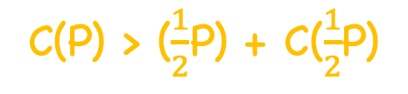
Fundamental Theorem of Software Engineering
C(P) > ($\frac{1}{2}$P) + C($\frac{1}{2}$P)
Due to complexity: It is always easier (and cheaper) to create two small pieces rather than one big piece if the two small pieces do the same job as the single piece. This is because combining two problems in one piece forces us to deal with the unneeded interactions between the two pieces
Yourdon, Edward; Constantine, Larry Structured Design, 1975
Notes:
Given some software that solves two problems, for example providing assigning a courier and pricing a cart, it will always be cheaper to break this into two problems: assigning a courier; pricing a cart due to unneeded interactions between those two parts.

Slide 7
Fundamental Theorem of Software Engineering
Specifically, we suggest that the cost of implementing a computer system will be minimized when the parts of the problem are:
• solvable separately
• manageably small
Of course, everyone has a different definition of "manageably small”
Yourdon, Edward; Constantine, Larry Structured Design, 1975
Notes:
Note that solvable separately does not exclude data coupling. One part my create data that the other uses. Provided that the dependency is stable. So for example producing a catalog and pricing a cart are coupled by the catalog, which contains the prices that the cart uses, but they are independently solvable, provided we have a stable catalog definition that we publish and the cart uses.

Slide 8
module: A module is a lexically contiguous sequence of program statements, bounded by boundary elements, having an aggregate identifier. Another way of saying this is that a module is a bounded, contiguous group of statements having a single name by which it can be referred to as a unit.
Yourdon, Edward; Constantine, Larry Structured Design, 1975
Notes:
“I consider a component as a particular form of module. I define modules as a division of a software system that allows us to modify a system by only understanding some well-defined subsets of it - modules being those well-defined subsets. Components are a form of module, with the additional property of independent replacement.”
I look as components today as coming in two guises: libraries and services.

Slide 9
software component: software components are things that are independently replaceable and upgradeable
- Martin Fowler, Software Component
- components come in two forms: libraries and services.
- components relate to modules, but are replaceable
Notes:
“I consider a component as a particular form of module. I define modules as a division of a software system that allows us to modify a system by only understanding some well-defined subsets of it - modules being those well-defined subsets. Components are a form of module, with the additional property of independent replacement.”
I look as components today as coming in two guises: libraries and services.

Slide 10
service: A service is a component that exists in its own process, clients talk to it over some inter-process communication mechanism: RPC, RESTful calls over HTTP, messaging, etc.
- Martin Fowler, Software Component
For services to be components:
- The upgrade/replacement of one service should not require co-ordination with another

Slide 11
autonomous component: it is an architectural style where the activation of the services within our system is under the control of the component itself as a response to timers, messaging etc. *
For services to be be autonomous components:
If you are autonomous from your business partners, you won't share transactions with them. Transactions aren't used across organizations since this may lock up YOUR database if the OTHER organization messes up. Without transactions, you must use multiple messages over time.
- They need to meet the criteria for a component
- They need to control their own activation; excludes RPC
- Pat Helland, Autonomous Computing
* This doesn’t include RPC, like Thrift or gRPC
Notes:
“What is common to all traditional building blocks is that their invocation happens through external events, such as start directives by users and call statements or messages by other software entities. Autonomous software exceeds this limitation of “external-only invocation” by additionally encapsulating invocation control. In other words, autonomous software significantly differs from traditional software in that it takes over responsibility for deciding (in accordance with the demands of its users and administrators) when and under what conditions to become active and to react on external events. “
It has many implementations over time: COM+, SOA 2.0, reactive architectures etc.
This differs from say a library, where the component’s code runs in the address space of the host process and invocation is by call and return, but also from an RPC server where the components code runs in its own address space but invocation is still by call and return from another service.

Slide 12
microservices: a set of practices for successfully building a software component architectural style (at scale):
- Componentization via Services*
- Infrastructure Automation
- Organized around Business Capabilities
- Decentralized Data Management
- Smart endpoints and dumb pipes
- Decentralized Governance
- Design for failure
- Products not Projects
Lewis, James Fowler ,Martin - Microservices
* It is a component and a service i.e. should be replaceable; does not require autonomy
Notes:
On the right => how we design our software
On the left => how we operate our software
https://martinfowler.com/articles/microservices.html#DesignForFailure

Slide 13
Benefits
Costs
- Strong Module Boundaries
- Distribution
- Independent Deployment
- Verification
- Technology Diversity
- Operational Complexity
- Fault Tolerance
- Skill Issues
- Cognitive Load (Code that fits in my head)
- Data: BI & ML
- After Fowler, Martin Microservice Trade-Offs
Notes:
Strong Module Boundaries: Microservices reinforce modular structure, which is particularly important for larger teams. (NOTE: strong module boundaries lead to modules, which lead to parallelized work which lowers time to market…)
Independent Deployment: Simple services are easier to deploy, and since they are autonomous, are less likely to cause system failures when they go wrong.
Technology Diversity: With microservices you can mix multiple languages, development frameworks and data-storage technologies.
Fault Tolerance: Easier to keep providing a service to users despite the loss of some services; you don’t have all the eggs in one basket. Needs reactive architecture
Cognitive Load: Decompose a large problem into smaller ones
Distribution: Distributed systems are harder to program, since remote calls are slow and are always at risk of failure.
Operational Complexity: You need a mature operations team to manage lots of services, which are being redeployed regularly.
Verification: It is harder to verify both in test and production, whilst there are valid techniques, it is more complicated than within a monolith
Skill Issues: The engineers need skills like cloud native, messaging etc.
Analytics: As microservices hide the state, how do we report across them?

Slide 14
Microservice Premium
don't even consider microservices unless you have a system that's too complex to manage as a monolith
- Fowler, Martin Microservice Premium
- Code doesn’t fit in your head
- A Five-Pizza Team
You are solving **large** problems
- Sub-domains have different forces for change
- A wide range of interactions
Notes:
So my primary guideline would be don't even consider microservices unless you have a system that's too complex to manage as a monolith. The majority of software systems should be built as a single monolithic application. Do pay attention to good modularity within that monolith, but don't try to separate it into separate services.
Code doesn’t fit in your head: There is only so much complexity we can handle; it’s a combination of LOC, domain complexity, solution space complexity etc.
A Fve Pizza Team: An AWS two pizza team is about 12 people. AWS splits work up when the team required to look after it exceeds 12 people. A five pizza team is about 30 people. This is a good rule of thumb for when microservices may start to pay dividends, by allowing you to parallelize work
Forces for change: When sub-domains have very different forces for change, such as different departments within the organizational stuctture they tend to want to move according to very different forces and alignment is very difficult
Wide range of interactions: if there are very different ways that the business surfaces its interactions to very different customer types

Slide 15
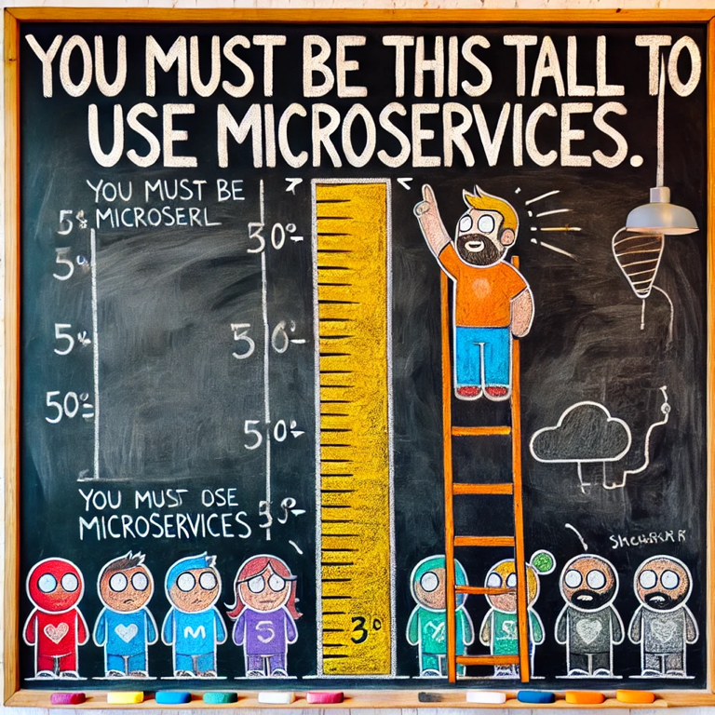

Slide 16
The Problem
Parents wonder why the streams are bitter, when they themselves poison the fountain.
― John Locke,

Slide 17
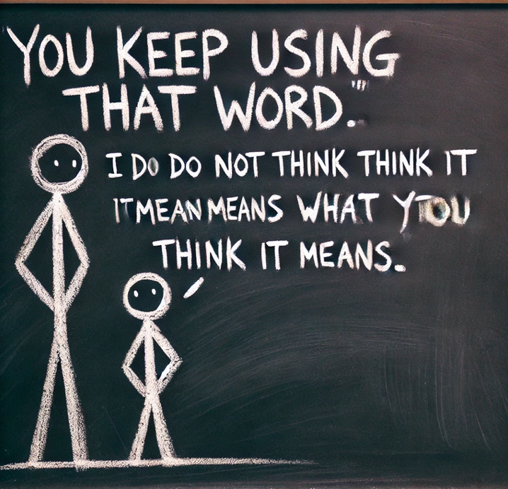
Microservices
“They are very, very small. I mean 100 lines of code is probably a big service these days.” Fred George, Barcelona Ruby Conference
“If its more than one programmer to develop & design and maintain it, it’s not a microservice” Fred George, GOTO 2016
“If something starts to be big enough that you view it as an asset that’s worth preserving, then it’s too big and you should target it for destruction” – Michael Nygard, GOTO 2016
Notes:
From the outset, usage of the word micro was coupled to a belief that they should be small. Advocates spoke about size, such as Fred George or many of the panellists at GOTO 2016 (Jessica Kerr was the person on the panel who suggested size ought to be bound to the problem – “listen to women” people)

Slide 18
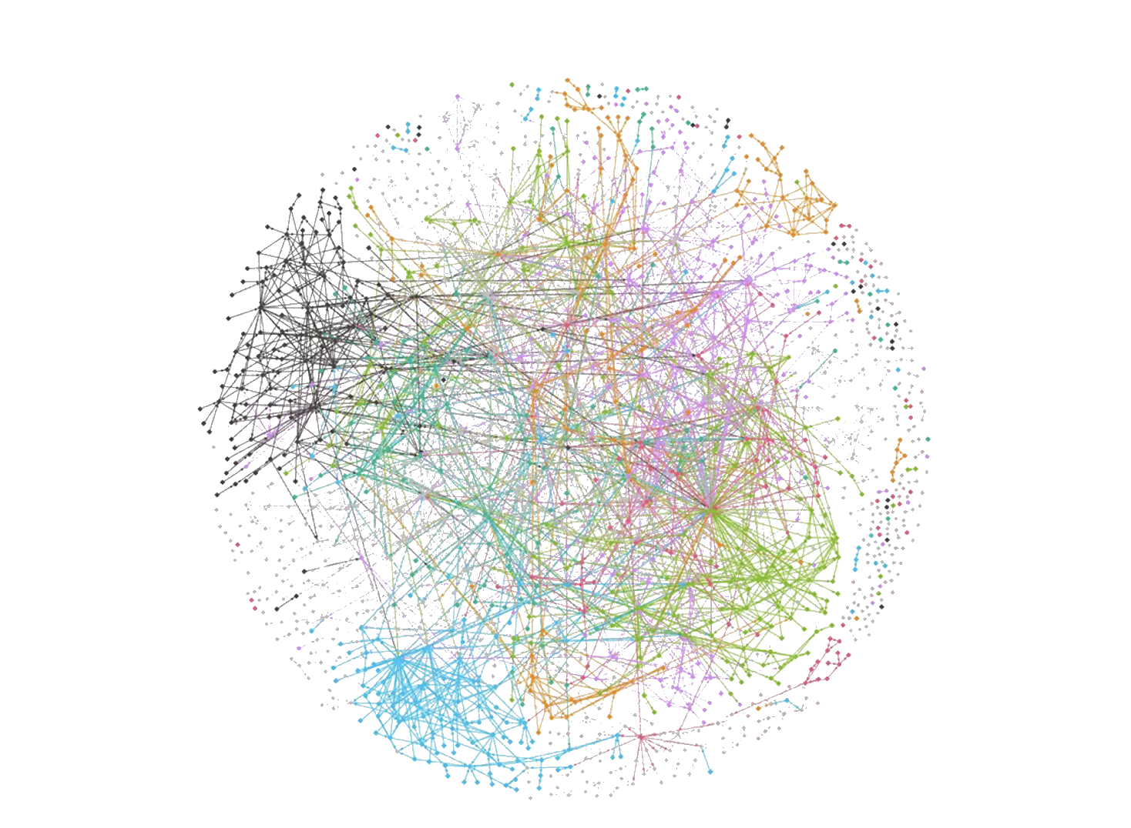
Nanoservices
Synchronous Orientation
Many Integration Points
Low Cohesion, High
Coupling
High Latency
Long Release Cycles
High Operational Overhead
Obstacle to Reasoning
Nanoservice – Where the overhead of a being service not balanced by the value.
Notes:
An obsession with size as the defining characteristic of microservices leads to nanoservices
Many Integration Points: Each connection between a service is an integration point. Any integration point is a threat to stability because it can and will fail. Increasing the number of connections, increases the number of failures.
High Latency: The likelihood of a service calling one or more other services to furnish a response increases as we become more fine-grained. Each additional call adds a network latency overhead to the time to respond from the originating request.
High Operational Overhead: Each service carries with it an overhead - monitoring and logging, on-call support, build pipelines etc. The more services we have, the higher the operational overhead. There is a tipping point at which further distillation of the problem into components costs us more in effort than we gain from distributing the problem amongst many teams.
Synchronous Orientation: Fine-grained architectures often result from synchronous architectures. These are simple to build, because an in-process call is moved out-of-process. However, because the services are not truly independent, as they would be in an event-based architecture, we are open to cascade failure through temporal coupling.
Low-cohesion, high coupling: Too many services often lead to low-cohesion as any requirements are spread across multiple services, which all need to change. Instead of one team being able to handle the change, we end up with change impacting multiple backlogs. We have created release coupling which undermines the value from the independent deployability that we sought. This is sometimes known as a distributed big ball-of-mud because it suffers from all the problems of a ball-of-mud, but is worse because it carries the overhead of distribution.
Long Release Cycles: As described under low cohesion, high coupling (above), fine-grained services tends to mean that we must perform shotgun surgery when we make a change. We have to create a programme of work to co-ordinate delivery from multiple team’s backlogs. Co-ordinating multiple backlogs means a team may finish, and then wait for other teams to release and thus get feedback on their work. The resultant long feedback loop moves us away from agile delivery and contribute towards the likelihood of rework. The long release cycle also creates inventory waste as value from work done cannot be realized until all the work is complete.
Obstacle to Reasoning: It becomes hard to reason about the system. Good architectures make it possible for us to reason about the system. Can I easily reason about what components are involved in a user journey in the system? If I want to change functionality in the product, can I simply determine who owns that change? If I need to onboard new engineers, how easy is it for them to grasp how the services fit together? If our solution is too fine-grained the answer will be many owners, and our system becomes hard to reason about.

Slide 19


Microservices
=
Each service is autonomous and self-contained and runs a unique process. PaloAltoNetworks.com
Microservice
Process
Each microservice is packaged as a Docker container to enable deployment to a Kubernetes cluster for application orchestration. ThinkMicroservices.com
=
Microservice
Pod
A cloud native application consists of discrete, reusable components that are known as microservices that are .. packaged in containers IBM.com
=
functions .. launched by AWS Lambda, is all that you need to build a microservice … to the level of granularity desired AWS.Amazon.com
Microservice
FaaS
Notes:
Remember that a service is just a software component that runs in its own process/address space
So the word service implies that a microservice is a software component that runs as a process. A SINGLE process.
This then tends to get interpreted to imply that a microservice is a physical boundary and implies a single process (address space) on bare metal/vm or run as a container in Docker or K8s or a lambda function (or Azure function etc.)

Slide 20
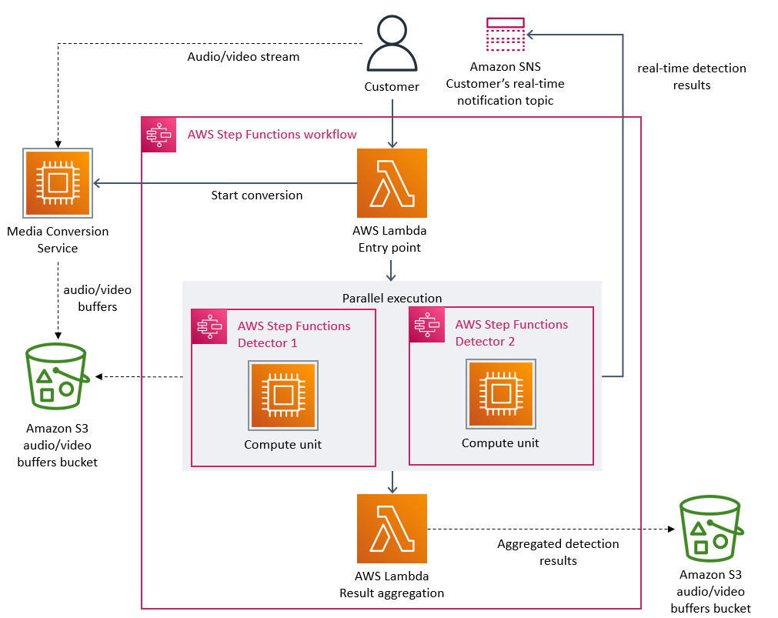
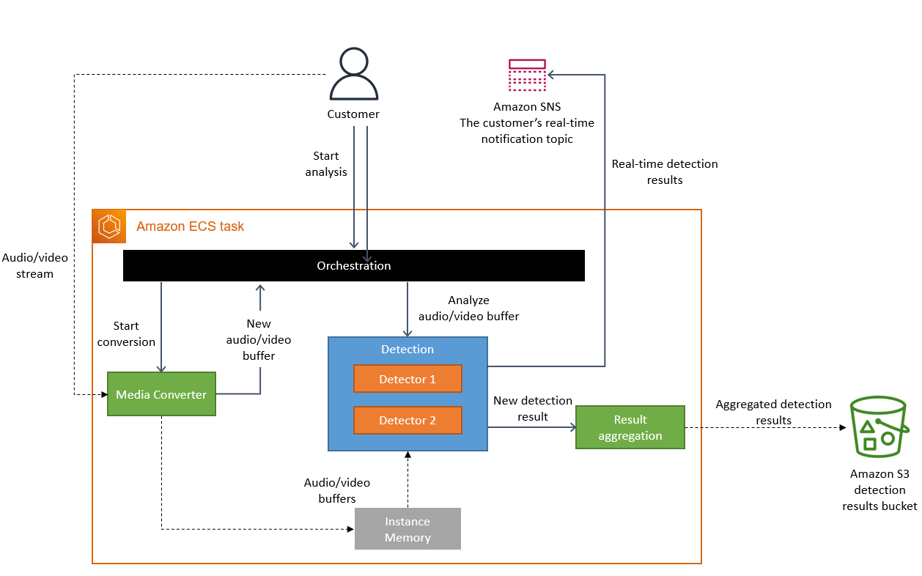
Prime Video
Source: Prime Video Tech (Archived)
From distributed microservices to a monolith application
We realized that distributed approach wasn’t bringing a lot of benefits in our specific use case, so we packed all of the components into a single process.
Notes:
An obsession with service as a single process leads us to believe that if we change the process family that we use to provide some functionality we are changing the microservice boundaries.
AWS Prime Video released a blog post where they described moving from two lambdas to a single EKS pod and called it a move from microservices to a monolith, because they had moved from a process family of two, to one.
Changing your process model is not moving from microservices to a monolith
Note that the original post is now not available from AWS but is archived: https://web.archive.org/web/20240121215100/https://www.primevideotech.com/video-streaming/scaling-up-the-prime-video-audio-video-monitoring-service-and-reducing-costs-by-90

Slide 21
Even Amazon can't make sense of serverless or microservices
That really sums up so much of the microservices craze that was tearing through the tech industry for a while: IN THEORY. Now the real-world results of all this theory are finally in, and it's clear that in practice, microservices pose perhaps the biggest siren song for needlessly complicating your system. And serverless only makes it worse.
― Hansson, David Heinemeier blog

Slide 22
Fracture Plane: Team Availability
A fracture plane is a natural seam in the software system that allows the system to be split easily into two or more parts….
Skelton, Matthew; Pais, Manuel. Team Topologies
Fracture plane: team availability is an anti-pattern that occurs when the driving decision is that we want to create a fracture plane to support a new team working on the problem over assigning to an existing team, for the whom the work may not represent the highest priority, to achieve faster time-to-market.
Fracture plane: team availability leads to poor cohesion at best, high coupling at worst. It may lead to nanoservices.
Notes:
Partitioning is one of the fundamental architectural decisions – significant in terms of cost (hard to undo) and how we reason about our software (these are the boxes in the boxes and lines diagrams that we will scratch on the whiteboard). Team Topologies identifies “fracture planes” as the points at which we should make these partitions

Slide 23
Cost of Ownership
The cost of ownership of software exceeds the cost of authorship (proof: assume a two-pizza team takes 3 months to write software but 36 months owning it, the cost of ownership is an order of magnitude greater).
Reducing the cost of authorship improves the time to market. In a context where speed of feature release wins we risk prioritizing fracture plane: team availability.
But over time a growing number of components will bankrupt us as ownership costs rise-and rise.
Notes:
We saw the intermodule effects

Slide 24
Cost
Intermodule effects grow as the number of components increases
Intramodule effects
Intermodule effects
Total Cost
Intramodule effects decrease as the number of components increases and module size lowers
Edward Yourdon, Larry Constantine, Structured Design 1975
Number of components
Notes:
The principles of structured design would seem to hold true even at the level of services – smaller microservices suffer less from internal complexity but the complexity of having many microservices grows. At some point we tip over from lower microservice size decreasing cost through reduction of complexity of the microservice to increasing cost through the ownership of many services.

Slide 25
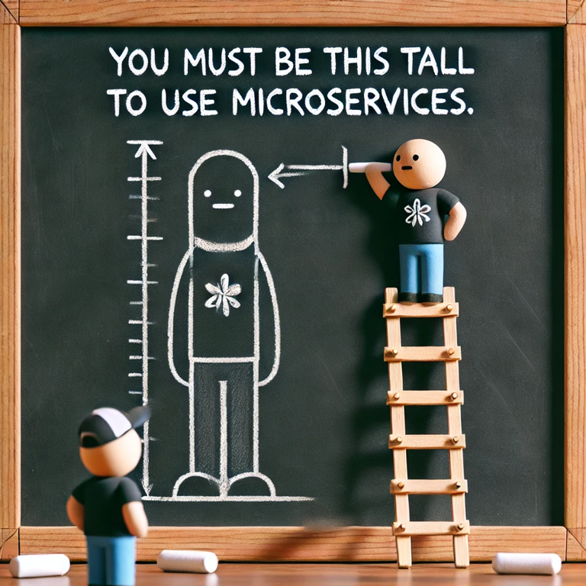

Slide 26
Advice
Why is it that a child sometimes does the opposite of what he is told? Why would a person sometimes dislike receiving a favor? Why is propaganda frequently ineffective in persuading people? And why would the grass in the adjacent pasture ever appear greener?.
― Jack Brehm, 1966
Notes:
Brehm reactance theory: we dislike advice or help because it takes away our freedom to choose for ourselves

Slide 27
The “4 +1 “ View Model - Philippe Kruchten
Logical
Development
Scenarios
Process
Physical
- See Chris Simon, Experiences scaling a modular monolith to microservices using the 4+1 views
Notes:
Each view is described by a blueprint using its own particular notation. For each view also, the architects can pick a certain architectural style, hence allowing the coexistence of multiple styles in one system. Architectural Blueprints the 4 +1 View Model of Software, Philippe Kruchten
Scenarios: The requirements. Expressed as use cases, user stories etc.
Logical View: The requirements expressed as a domain model. Classes and associations, composition, inheritance. On a more macro scale, sub-domains
Development view: The fracture planes of the system, how we divide up into modules, components, services, bounded contexts. The realm of the context map
Process: The threads of execution. Concurrency, processes, interoperability between those processes
Physical: How we deploy those processes

Slide 28
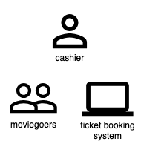
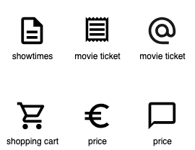
Scenarios
Activities: An activity describes the relationship of the actor to the work object – what do they do to it?
Actors: systems or people the story
is about
offers
buys
Work Objects: actors work with or exchange information about work objects: resources in the domain
Domain Storytelling
Notes:
We capture functional requirements through use cases, user story mapping or techniques like domain storytelling

Slide 29
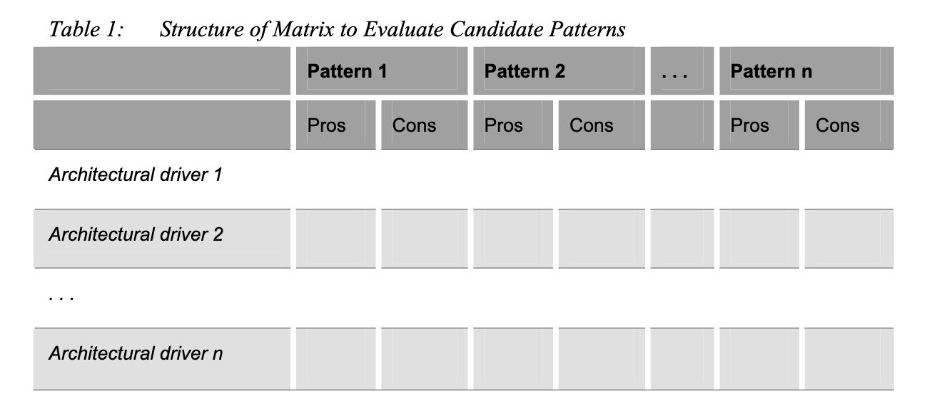
Scenarios
Attribute Driven Design
Notes:
We scenarios for our quality attributes (modifiability, interoperability, availability, performance, security etc) for use with attribute based evaluation of our designs

Slide 30
The “4 +1 “ View Model - Philippe Kruchten
Logical
Development
Scenarios
Process
Physical
- See Chris Simon, Experiences scaling a modular monolith to microservices using the 4+1 views
Notes:
Each view is described by a blueprint using its own particular notation. For each view also, the architects can pick a certain architectural style, hence allowing the coexistence of multiple styles in one system. Architectural Blueprints the 4 +1 View Model of Software, Philippe Kruchten
Scenarios: The requirements. Expressed as use cases, user stories etc.
Logical View: The requirements expressed as a domain model. Classes and associations, composition, inheritance. On a more macro scale, sub-domains
Development view: The fracture planes of the system, how we divide up into modules, components, services, bounded contexts. The realm of the context map
Process: The threads of execution. Concurrency, processes, interoperability between those processes
Physical: How we deploy those processes

Slide 31
Logical
The logical architecture primarily supports the functional requirements—what the system should provide in terms of services to its users. The system is decomposed into a set of key abstractions, taken (mostly) from the problem domain
Kruchten, Philippe Architectural Blueprints the 4 +1 View Model of Software
This is where we explore our requirements, typically a domain model

Slide 32
Logical
A fracture plane is a natural seam in the software system that allows the system to be split easily into two or more parts…. It is usually best to try to align software boundaries with the different business domain areas…
Skelton, Matthew; Pais, Manuel. Team Topologies
How do we find these sub-domains within our system?
- Natural seams within the domain understood by SMEs
- Domain Storytelling
- Value Stream Mapping to align with processes
Notes:
A key activity when thinking about microservices is how we partition our domain into independently solvable problems or sub-domains. Team topologies call these seams fracture planes

Slide 33
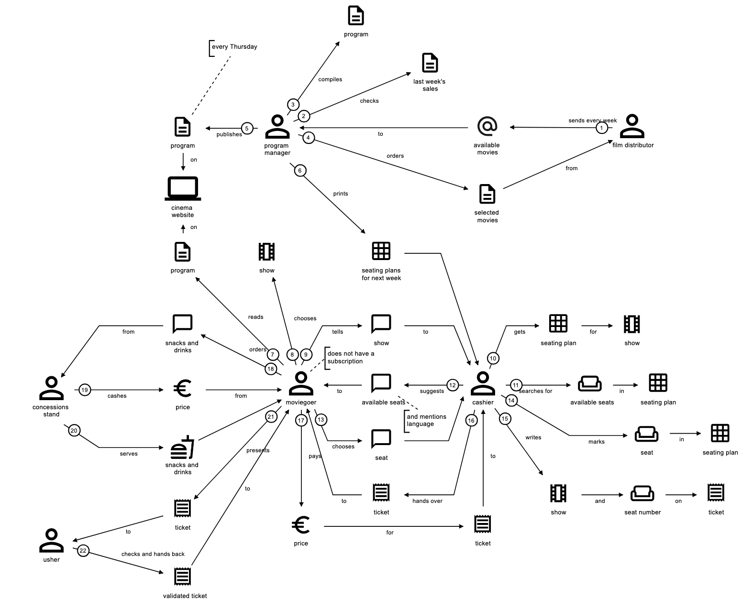
Domain Storytelling
Examples

Slide 34
Domain Storytelling and Boundaries
Subdomains consist of activities that belong together from an actor’s perspective.
- Actor produces result on their own
- Activities supporting something not in the picture
- One-way information flow
- Differences in language
- Different triggers
- Different use of the same thing
Hofer, Stefan; Schwentner, Henning. Domain Storytelling
Notes:
Actor produces result on their own: An actor completes several related activities independently, producing a meaningful outcome. Often, the actor then passes the result on to other actors. An example is “risk assessment,” as shown in Figure 10.4.
One-way information flow: A handover between actors—an actor A transfers a work object to actor B, and there is no information flowing back to actor A (neither directly nor indirectly). This means that A is not involved in whatever B does with the transferred work object.
Different triggers: Customer service agent Charley has told us that the customer’s inquiry triggers the offering—an example of a request-based trigger. Once the car has been handed over, the customer must pay the monthly installment—an example of a time-based trigger
Activities supporting something that is not in the picture: In another domain story, Raymond tells us that creating a “risk report” is one of the risk managers’ activities. However, this risk report is not used by other actors in the story. Since the report was created for a reason, it will probably be used in another subdomain that is not relevant for this domain story.
Differences in language: The same work object is given different names by different actors. Or the same name is used with a (slightly) different meaning. (The second case is much harder to spot.)
Different use of the same thing: The same work object is used for significantly different tasks. For example, at Alphorn, the contract is “signed” by the customer and “voted” by risk managers. Signing is a legal act that creates a relationship. Voting takes place in a financial context—it is done to mitigate the financial risk for Alphorn.
Hofer, Stefan; Schwentner, Henning. Domain Storytelling (Addison-Wesley Signature Series (Vernon)) (p. 138). Pearson Education. Kindle Edition.

Slide 35
Domain Storytelling
Examples
Notes:
These are independently solvable parts of our domain. They do not all have the same number of work item interactions, suggesting some are more complex than others, and will thus be of different sizes. The interaction between the ticket system and the reservation system is interesting: there will be a transaction in which we reserve a ticket ahead of assigning it. Doing this in a separate process from the ticket system means we will need to use inter-process communication during that reservation, this will add complexity.

Slide 36
Logical
The Domain will change as the business changes:
- The changes to our domain will be a constant force; a successful business is not static
- Tasks and activities change more frequently, are retired, replaced or introduced
- Processes change more slowly, are less frequently retired, replaced; may be more frequently introduced as new opportunities emerge.
- Our logical view requires constant gardening
- We need a continuous conversation to share the logical model as it changes.

Slide 37
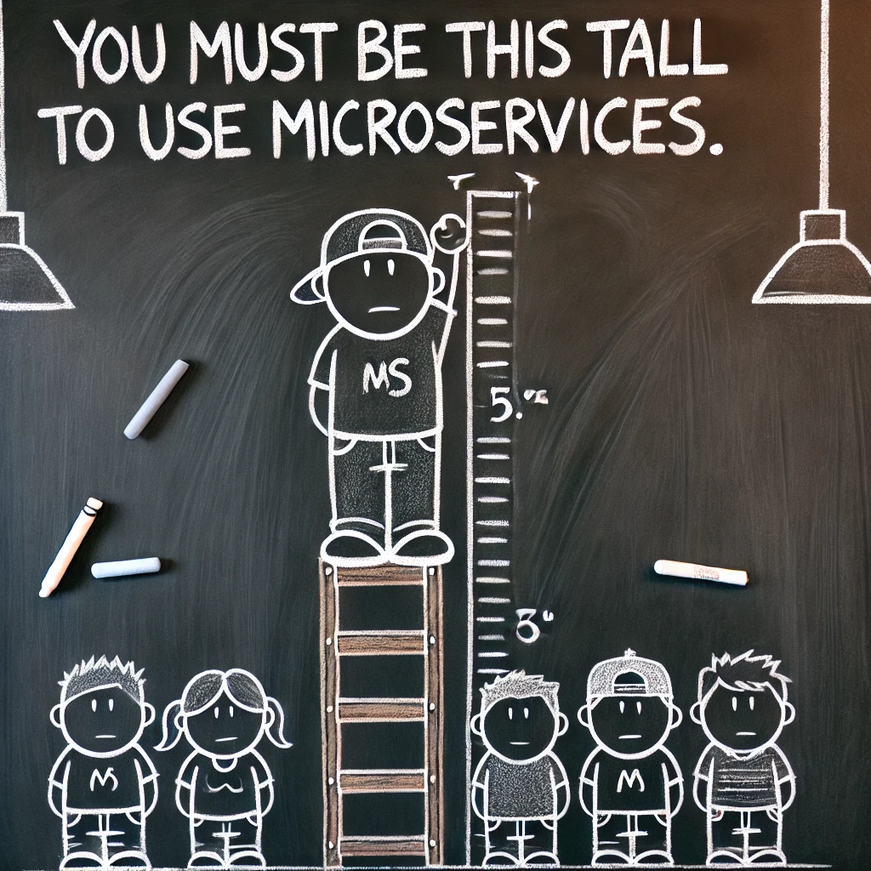

Slide 38
The “4 +1 “ View Model - Philippe Kruchten
Logical
Development
Scenarios
Process
Physical
- See Chris Simon, Experiences scaling a modular monolith to microservices using the 4+1 views
Notes:
Each view is described by a blueprint using its own particular notation. For each view also, the architects can pick a certain architectural style, hence allowing the coexistence of multiple styles in one system. Architectural Blueprints the 4 +1 View Model of Software, Philippe Kruchten
Scenarios: The requirements. Expressed as use cases, user stories etc.
Logical View: The requirements expressed as a domain model. Classes and associations, composition, inheritance. On a more macro scale, sub-domains
Development view: The fracture planes of the system, how we divide up into modules, components, services, bounded contexts. The realm of the context map
Process: The threads of execution. Concurrency, processes, interoperability between those processes
Physical: How we deploy those processes

Slide 39
Development
The development architecture focuses on the actual software module organization on the software development environment. The software is packaged in small chunks—program libraries, or subsystems — that can be developed by one or a small number of developers. The subsystems are organized in a hierarchy of layers, each layer providing a narrow and well-defined interface to the layers above it.
Kruchten, Philippe Architectural Blueprints the 4 +1 View Model of Software
This is where we define the service boundaries that map to the logical model

Slide 40
Development
A fracture plane is a natural seam in the software system that allows the system to be split easily into two or more parts…. It is usually best to try to align software boundaries with the different business domain areas… Fracture Plane: Business Domain Bounded Context
Skelton, Matthew; Pais, Manuel. Team Topologies
Multiple [domain] models are in play on any large project. Explicitly define the context within which a [domain] model applies. Explicitly set boundaries in terms of team organization, usage within specific parts of the application, and physical manifestations such as code bases and database schemas. Keep the [domain] model strictly consistent within these bounds, but don’t be distracted or confused by issues outside. A BOUNDED CONTEXT delimits the applicability of a particular [domain] model.
Evans, Eric Domain-Driven Design
Notes:
A bounded context is really: people, process and technology sharing a ubiquitous language; it is a strong definition of a business capability. A bounded context exists in the development view, not the logical view. It is not a slice of our domain model, it is how we action building a slice of our domain model.

Slide 41
Many designers have made attempts to chop a system into manageably small pieces; unfortunately, they have often found that implementation time increased rather than decreased. The key frequently lies in the second part of our stipulation above: The parts of the original problem must be solvable separately.
Yourdon, Edward; Constantine, Larry Structured Design, 1975
Notes:
Becoming obsessed with the size/cognitive load of a microservice may lead to us choosing to map a bounded context to an activity or task within the bounded context that does not represent a separately solvable problem within the domain. This will cause particular pain if we do it across a distribution boundary where we have consciously made the integration cost higher in order to enforce the module boundary.
Some problems are bigger than one team and hard to fit in our head, but can’t be easily teased apart without adding greater complexity through intermodule dependencies that themselves would make the parts too complex to understand because of the added costs now of distribution of the problem anyway.
In process modules are a softer boundary, and can help here, though you may get a ball of mud if the problem keeps wanting to break the modules apart. This is why we suggest strategies like microkernel here.

Slide 42
Cost
Intermodule effects grow as the number of components increases
Intramodule effects
Intermodule effects
Total Cost
The Goldilocks Point
Intramodule effects decrease as the number of components increases and module size lowers
Yourdon, Edward; Constantine, Larry Structured Design 1975
Number of components
Notes:
The principles of structured design would seem to hold true even at the level of services – smaller microservices suffer less from internal complexity but the complexity of having many microservices grows. At some point we tip over from lower microservice size decreasing cost through reduction of complexity of the microservice to increasing cost through the ownership of many services.

Slide 43
Granularity Integrators and Disintegrators
Granularity Disintegrators
Granularity Integrators
Service scope too large
ACID transactions
Distribution of code changes
Shared Code
Continuous change for new problems
Shared Data
After Ford, Neal; Richards, Mark; Sadalage, Pramod; Dehghani, Zhamak. Software Architecture: The Hard Parts
Notes:
Service scope and function Is the service doing too many unrelated things?
Code volatility Are changes isolated to only one part of the service?
Scalability and throughput Do parts of the service need to scale differently? [NOT HERE: Process]:
Fault tolerance Are there errors that cause critical functions to fail within the service? [NOT HERE: Process]: Security Do some parts of the service need higher security levels than others? [NOT HERE: Process]:
Extensibility Is the service always expanding to add new contexts?
Granularity Integrators :
Database transactions Is an ACID transaction required between separate services?
Workflow and choreography Do services need to talk to one another?
Shared code Do services need to share code among one another?
Database relationships Although a service can be broken apart, can the data it uses be broken apart as well?
Ford, Neal; Richards, Mark; Sadalage, Pramod; Dehghani, Zhamak. Software Architecture: The Hard Parts (pp. 321-322). O'Reilly Media. Kindle Edition.

Slide 44
Development
Simple model: one bounded context per subdomain (two-pizza team).
- Code for the subdomain is fits neatly into your head
- Forces for change or replacement are cohesive: keep what changes together, together
- Allows ACID requirements to be satisfied within the service boundary
- This is the ideal microservice
- The microservice approach to division is different, splitting up into services organized around business capability.
Lewis, James Fowler, Martin - Microservices

Slide 45
Development
Simple model: one bounded context per domain (two-pizza team).
- Code for the domain is much smaller than your head
- Should this be a module and combined with other domains in one bounded context?
- Is this domain truly independent of others? Does it have separate reasons to change?
- Are the behaviours about the same work item?
- Are we talking to ourself?
- Will we distribute a transaction without necessity?
- Will we weaken cohesion as a separate context?
- Are we likely to be a nanoservice?

Slide 46
Development
More complex model:
- Is the code for the domain larger than your head?
- Can you find seam(s) within the domain and split into multiple bounded contexts
- Within a business process look for activities within the process (in domain storytelling deal with different work items)
- Beware complexity of intermodule dependencies
- If there are multiple contexts, now define relationship between contexts
- If independently solvable each split within the domain becomes a microservice
- But might create dependency issue around transactions or shared data
- If not independently solvable you need a macroservice
- Might use modularity if the macroservice has non-independent bounded contexts

Slide 47
Development
Macroservice:
- not a monolith
- Has no more than 20 devs/3 teams working on the service (5 pizza rule?)
- May or may not have/need monorepo.
- Dependency management becomes a lot easier (though still non-trivial) the fewer the services/repos - better observability, debugging
Sridharan, Cindy @copyconstruct X

Slide 48
Development
We identified that our domain will change. This implies that the bounded contexts we have drawn will move out-of-alignment
When your components are services with remote communications, then refactoring is much harder than with in-process libraries.
Lewis, James Fowler ,Martin - Microservices
A hyperliminal system is a system where a complicated, ergodic, ordered system executes inside a complex, non-ergodic, disordered context... It is the job of the architect to design a structure for the complicated system that will allow it to survive as the complex context around it changes and moves.
O’Reilly Barry - Residues
Notes:
Remember the logical model is changing as the business changes, which means the two will become out of alignment!
- We are unlikely to get our logical model right first time anyway.
- We are also unlikely to get our mapping of domains to context right first time either.

Slide 49
Development
Kauffman identified the property of criticality… This means that at a certain level of N (nodes) and K (links), a system is resilient to unexpected changes and at the same time not so complicated that it collapses under the weight of managing its own resources.
A good parallel in the software industry is the comparison of monoliths (Low N and K) and microservices (high N and K). Criticality is finding the balance between these things.
O’Reilly Barry - Residues
Notes:
(Distributed) Big Ball of Mud is what happens when you don’t adapt your development model (bounded contexts) as your logical model (domain) changes.
Service granularity (too small or too big) impacts our ability to replace/refactor our microservices away from a ball of mud

Slide 50
Development

Slide 51
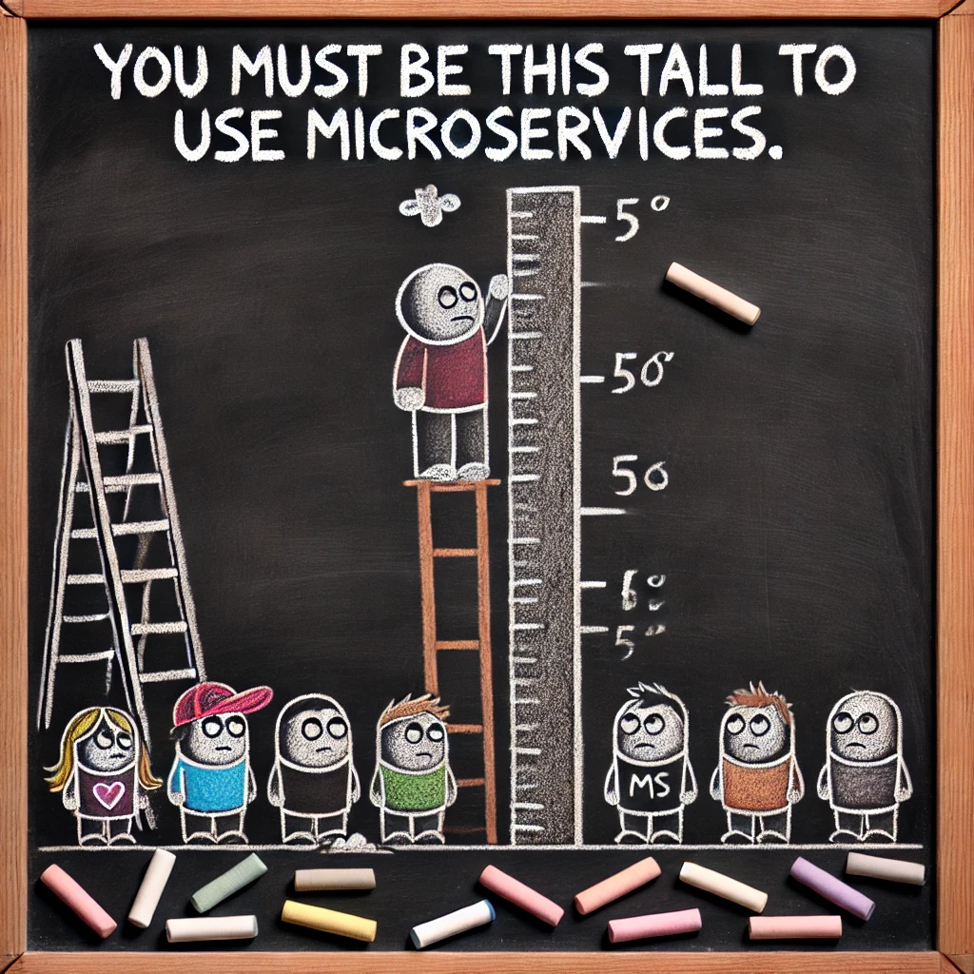

Slide 52
The “4 +1 “ View Model - Philippe Kruchten
Logical
Development
Scenarios
Process
Physical
- See Chris Simon, Experiences scaling a modular monolith to microservices using the 4+1 views
Notes:
Each view is described by a blueprint using its own particular notation. For each view also, the architects can pick a certain architectural style, hence allowing the coexistence of multiple styles in one system. Architectural Blueprints the 4 +1 View Model of Software, Philippe Kruchten
Scenarios: The requirements. Expressed as use cases, user stories etc.
Logical View: The requirements expressed as a domain model. Classes and associations, composition, inheritance. On a more macro scale, sub-domains
Development view: The fracture planes of the system, how we divide up into modules, components, services, bounded contexts. The realm of the context map
Process: The threads of execution. Concurrency, processes, interoperability between those processes
Physical: How we deploy those processes

Slide 53
Process
The process architecture takes into account some non-functional requirements, such as performance and availability. It addresses issues of concurrency and distribution, of system’s integrity, of fault-tolerance, and how the main abstractions from the logical view fit within the process architecture…A process is a grouping of tasks that form an executable unit. Processes represent the level at which the process architecture can be tactically controlled (i.e., started, recovered, reconfigured, and shut down)
Kruchten, Philippe Architectural Blueprints the 4 +1 View Model of Software
This is where we define the processes that make up a microservice

Slide 54
Process
This is about how our processes interoperate with each other and infrastructure
- Seek to be application-centric, not infrastructure centric
- 12-Factor Apps
Interoperability
- Autonomous Component
- Software Component
- Asynchronous communication
- Synchronous communication
- Independent Deployment
- REST: Independent deployment (uniform interface; resource versioning)
- Reactive Architecture
- RPC: Distributed Ball of Mud
- ECST

Slide 55
Process
At a first approximation, we can observe that services map to runtime processes, but that is only a first approximation. A service may consist of multiple processes that will always be developed and deployed together, such as an application process and a database that's only used by that service.
Lewis, James Fowler ,Martin - Microservices

Slide 56
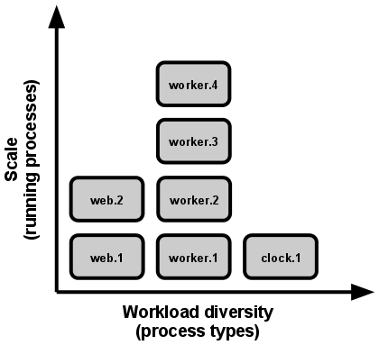
Process
In the twelve-factor app, processes are a first class citizen. Processes in the twelve-factor app take strong cues from the unix process model for running service daemons.
Using this model, the developer can architect their app to handle diverse workloads by assigning each type of work to a process type. For example, HTTP requests may be handled by a web process, and long-running background tasks handled by a worker process... the array of process types and number of processes of each type is known as the process formation
Concurrency - 12-Factor App

Slide 57
Process
=
μ
Microservice
App
=
Μ
Or
Plugin
Macroservice
App
App
Microkernel
Plugin
=
Or
Process Formation
App
Microkernel
Process
Type
Process
Type
Process
Type
Notes:
A microservice or microservice is a CI boundary => the app(s) & processes inside must build and pass automated tests as a whole. It does not need to be a deployment boundary, you can deploy parts, but you do have to then be aware of any versioning issues between the deployables, so that flexibility comes as a price

Slide 58
Granularity Integrators and Disintegrators
Granularity Disintegrators
Granularity Integrators
Scalability and throughput
ACID transactions
Fault tolerance
Shared Code
After Ford, Neal; Richards, Mark; Sadalage, Pramod; Dehghani, Zhamak. Software Architecture: The Hard Parts
Notes:
Service scope and function Is the service doing too many unrelated things?
Code volatility Are changes isolated to only one part of the service?
Scalability and throughput Do parts of the service need to scale differently? [NOT HERE: Process]:
Fault tolerance Are there errors that cause critical functions to fail within the service? [NOT HERE: Process]: Security Do some parts of the service need higher security levels than others? [NOT HERE: Process]:
Extensibility Is the service always expanding to add new contexts?
Granularity Integrators :
Database transactions Is an ACID transaction required between separate services?
Workflow and choreography Do services need to talk to one another?
Shared code Do services need to share code among one another?
Database relationships Although a service can be broken apart, can the data it uses be broken apart as well?
Ford, Neal; Richards, Mark; Sadalage, Pramod; Dehghani, Zhamak. Software Architecture: The Hard Parts (pp. 321-322). O'Reilly Media. Kindle Edition.

Slide 59
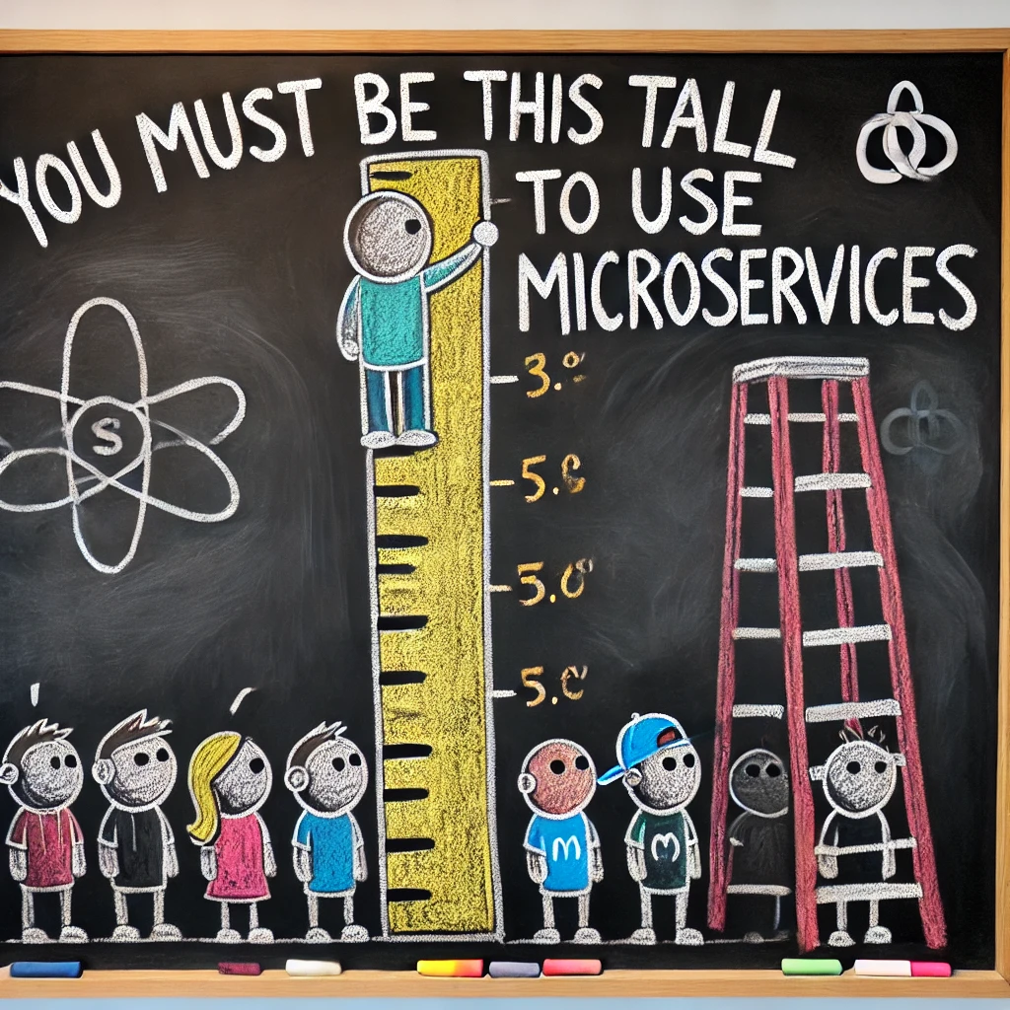

Slide 60
The “4 +1 “ View Model - Philippe Kruchten
Logical
Development
Scenarios
Process
Physical
- See Chris Simon, Experiences scaling a modular monolith to microservices using the 4+1 views
Notes:
Each view is described by a blueprint using its own particular notation. For each view also, the architects can pick a certain architectural style, hence allowing the coexistence of multiple styles in one system. Architectural Blueprints the 4 +1 View Model of Software, Philippe Kruchten
Scenarios: The requirements. Expressed as use cases, user stories etc.
Logical View: The requirements expressed as a domain model. Classes and associations, composition, inheritance. On a more macro scale, sub-domains
Development view: The fracture planes of the system, how we divide up into modules, components, services, bounded contexts. The realm of the context map
Process: The threads of execution. Concurrency, processes, interoperability between those processes
Physical: How we deploy those processes

Slide 61
Physical
The software executes on a network of computers, or processing nodes (or just nodes for short). The various elements identified—networks, processes, tasks, and objects—need to be mapped onto the various nodes. We expect that several different physical configurations will be used: some for development and testing, others for the deployment of the system for various sites or for different customers.
Kruchten, Philippe Architectural Blueprints the 4 +1 View Model of Software
This is where we map the processes to hosts

Slide 62
Physical
Process
Pod
Process
FaaS

Slide 63
Q&A
“Entities are not to be multiplied beyond necessity.” William of Ockham

